Slide 1
Capstone Design
Universal Mobile Robot
2016741012 문석준
2017741021 김태겸
2017741025 장재우
2017741052 최석원
May 02, 2022

Slide 2
Index
1
Project Concept
2
Current Process
3
Issues
4
Schedule

Slide 3
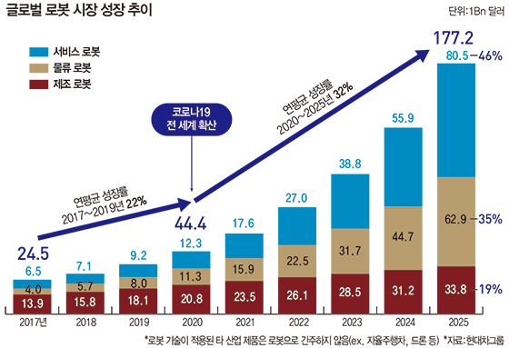
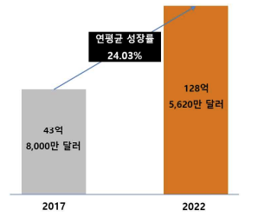
Project Concept
Ingrowing AMR & Service robot market
국제 AMR 시장 규모 및 전망(출처: 연구개발특구진흥재단)

Slide 4
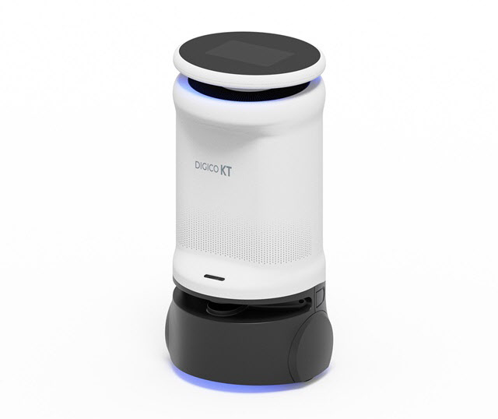
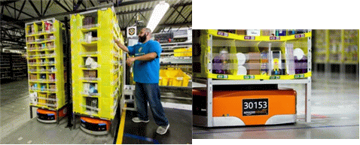
Project Concept
Problem about existing robots
Expensive price
KT 중소형 방역로봇
아마존(Amazon) Kiva
$20,000
$50,000

Slide 5
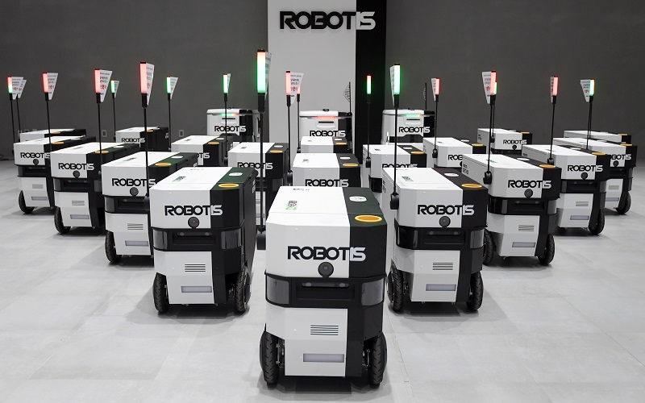
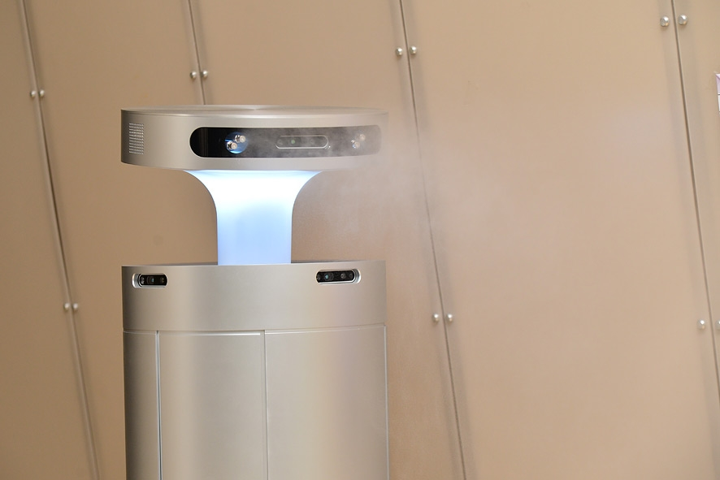
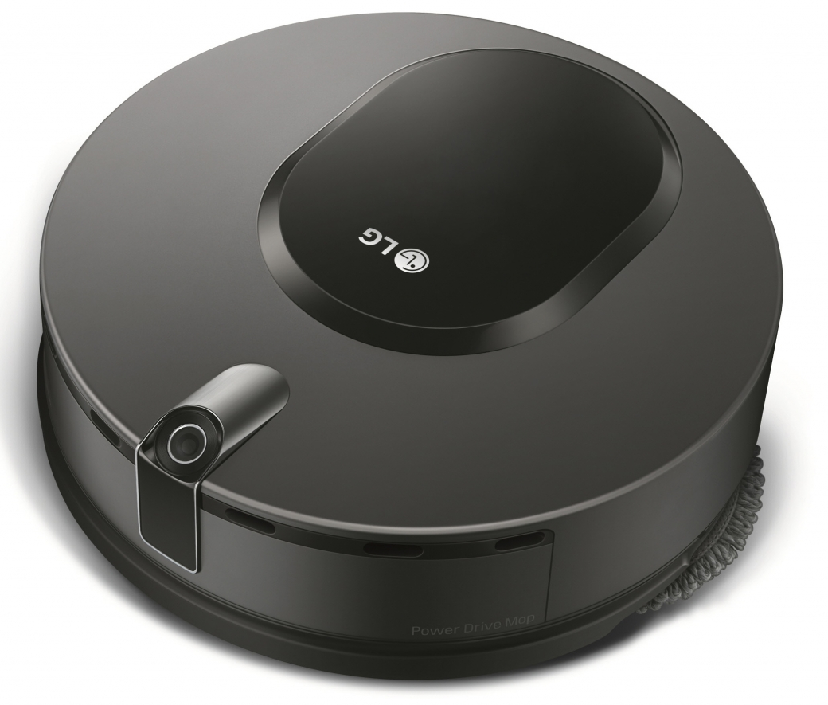
Project Concept
Problem about existing robots
One robot, one purpose
Fixed hardware, low adaptability

Slide 6
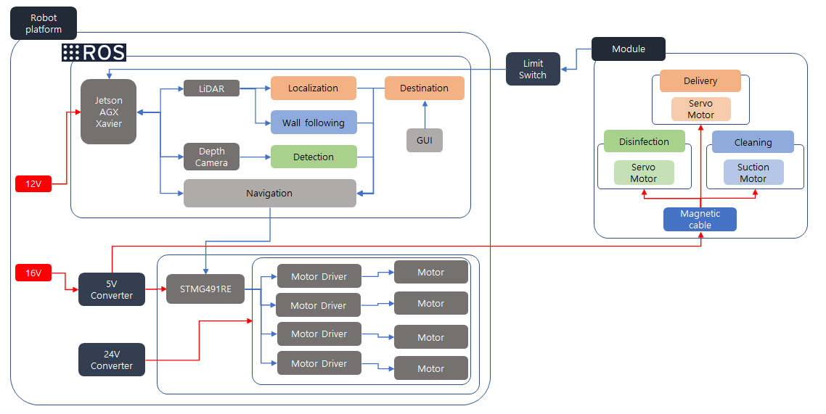
Project Concept

Slide 7
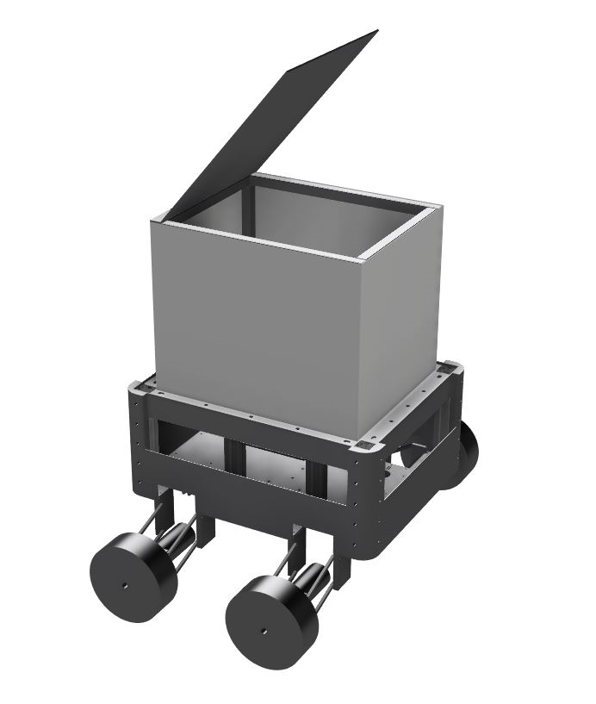
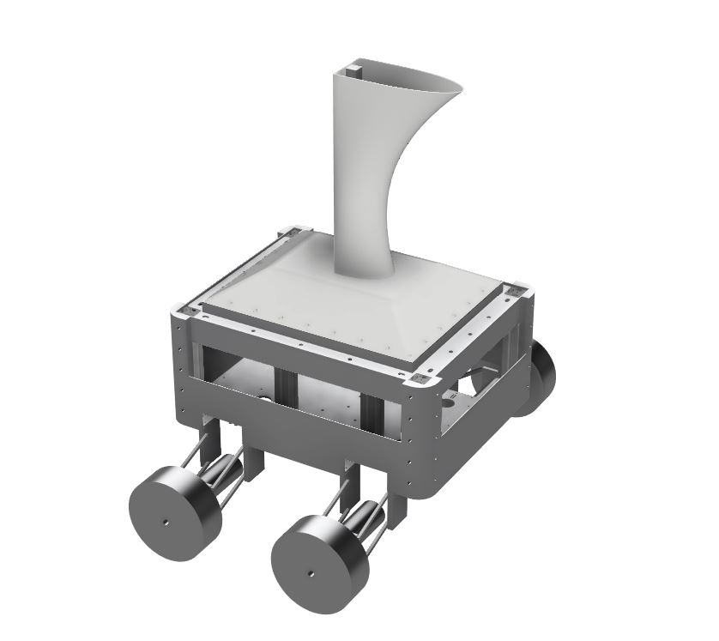
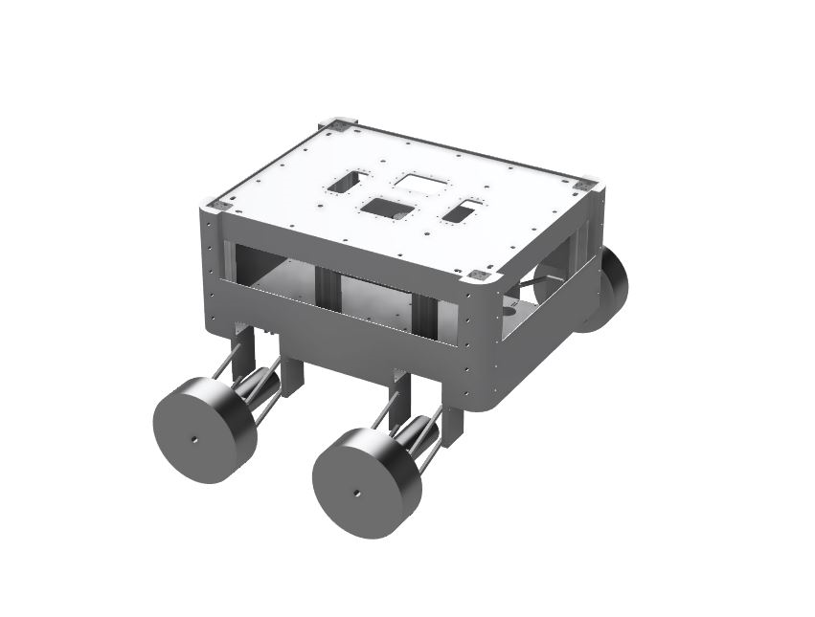
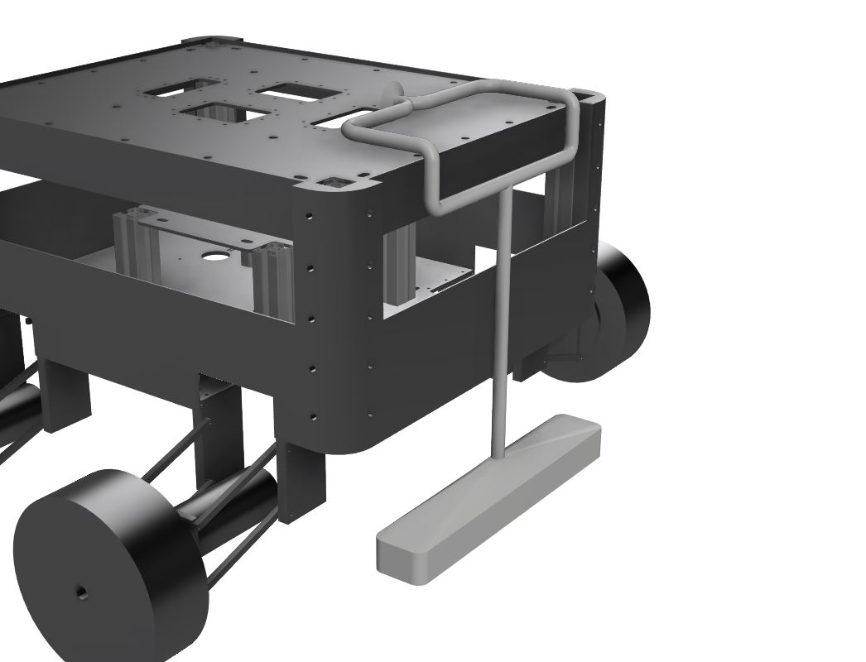
Project Concept
Proposal
One robot, many possibility
Changeable hardware, high adaptability
Robot platform + modules

Slide 8
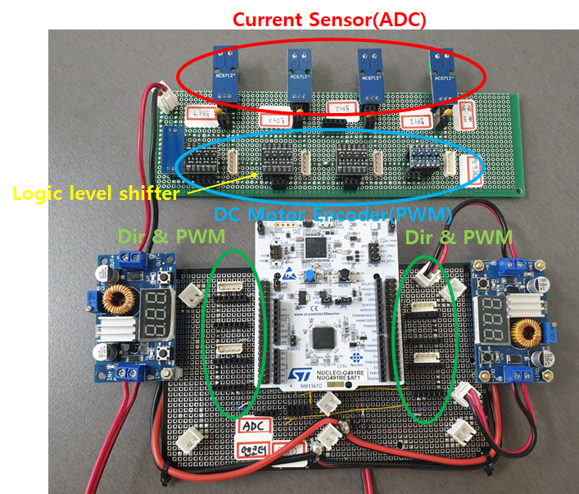
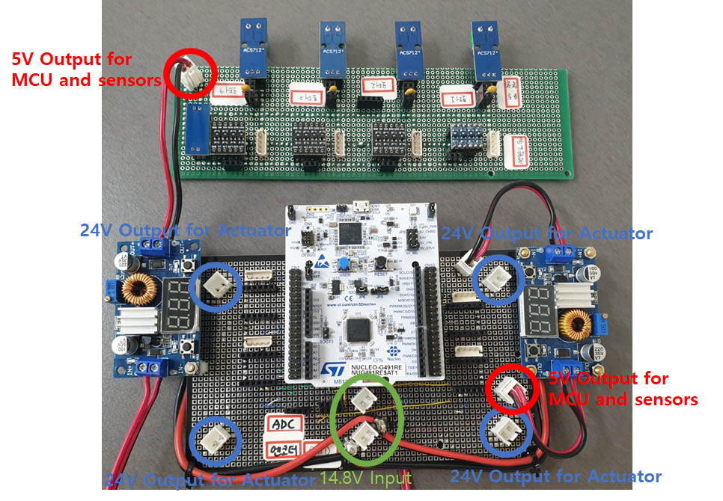
Current Process
Embedded system
Main voltage 16V
Motor 24V
MCU 3.3V (external 5V)

Slide 9
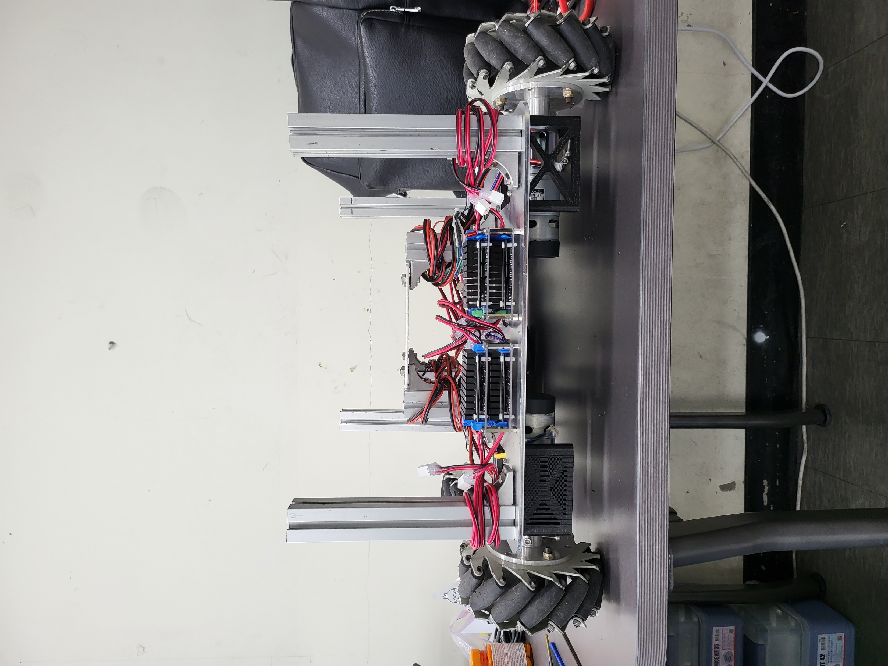
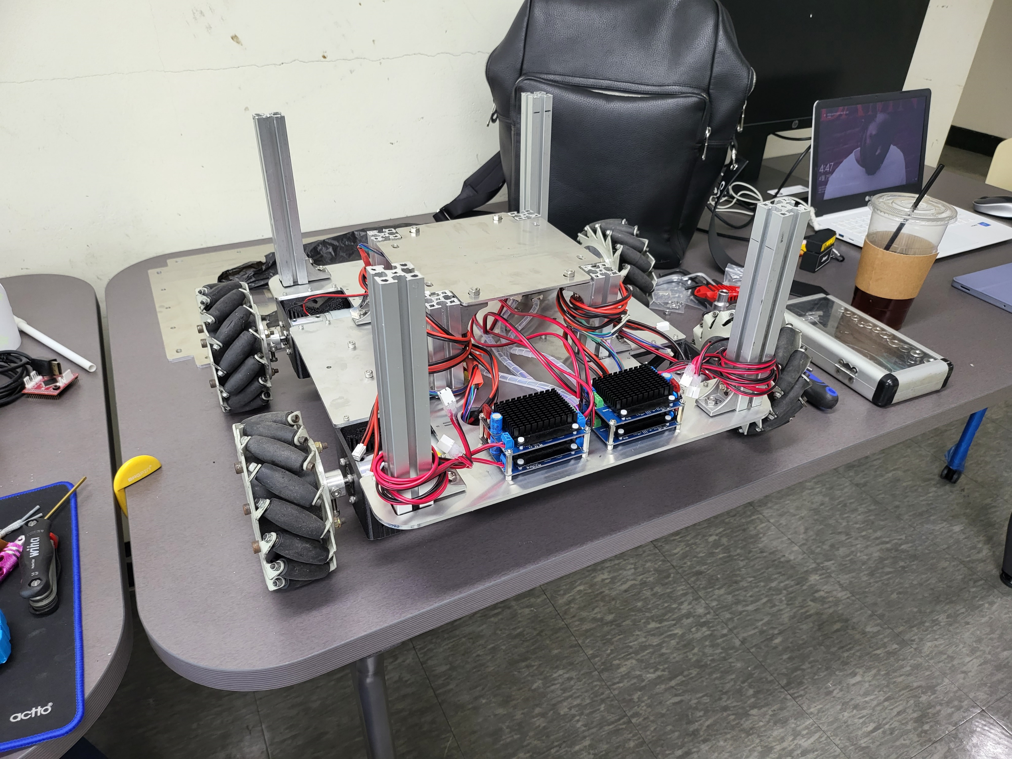
Current Process
Hardware assemble

Slide 10
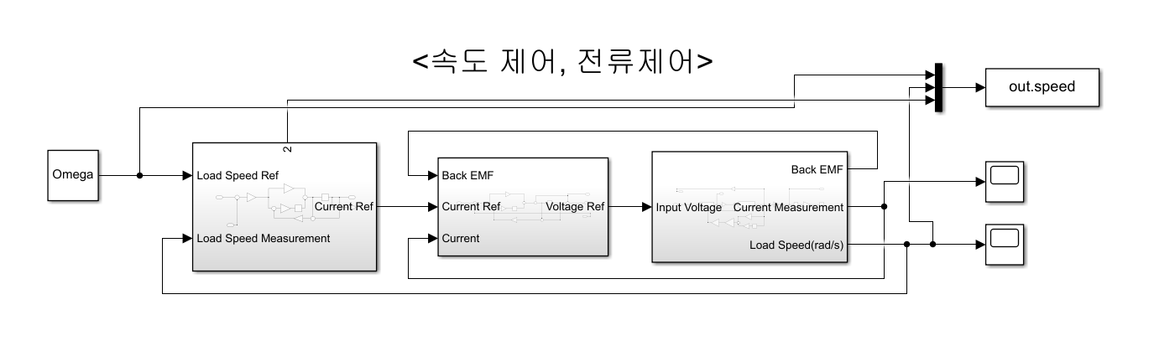
Current Process
Motor controller

Slide 11
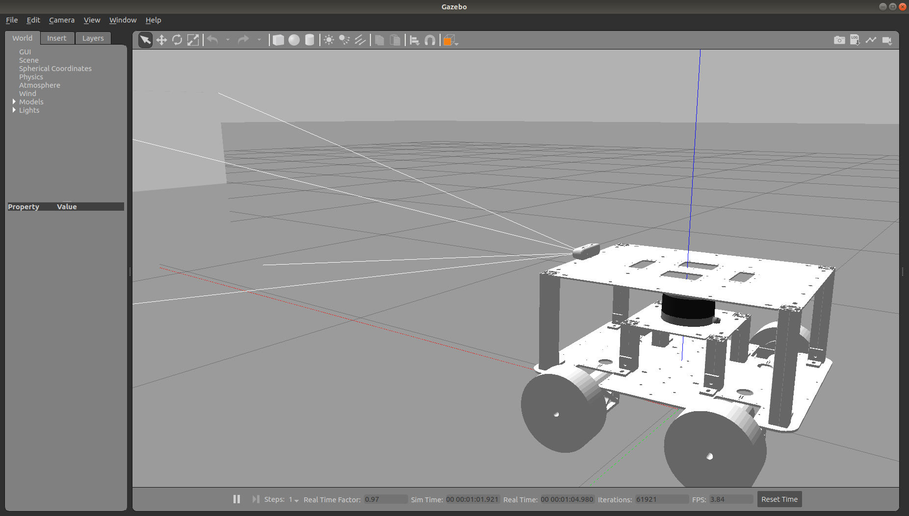
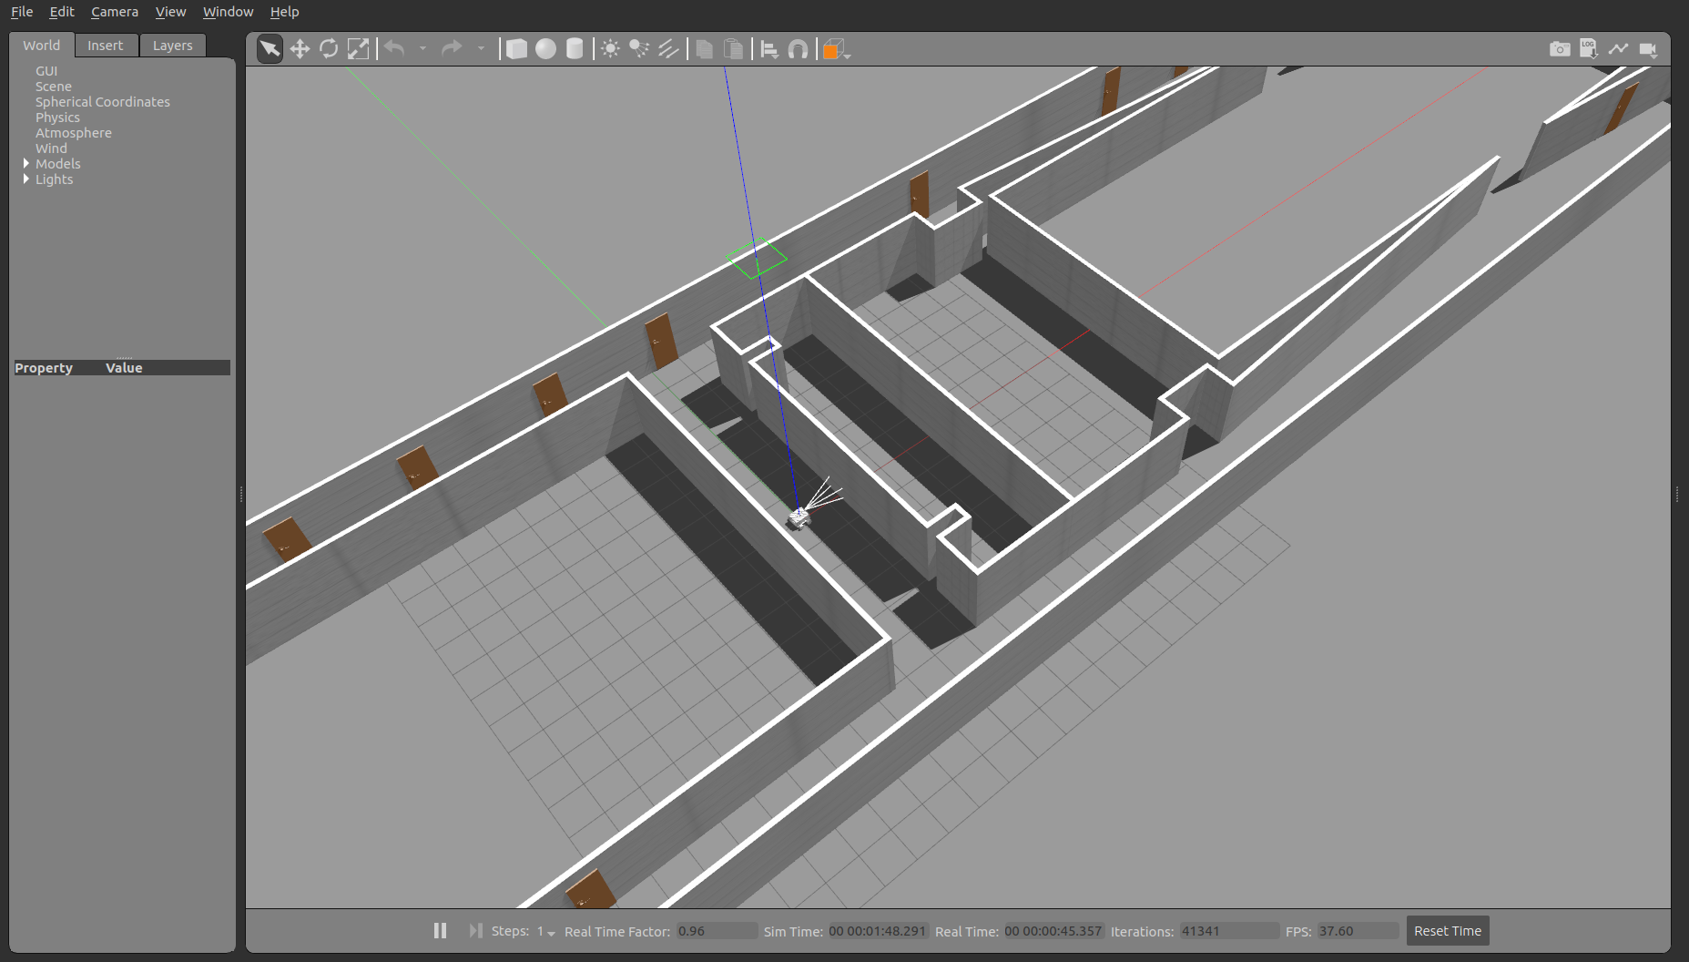
Current Process
Gazebo Simulation
Robot platform
Nuri 3rd world

Slide 12
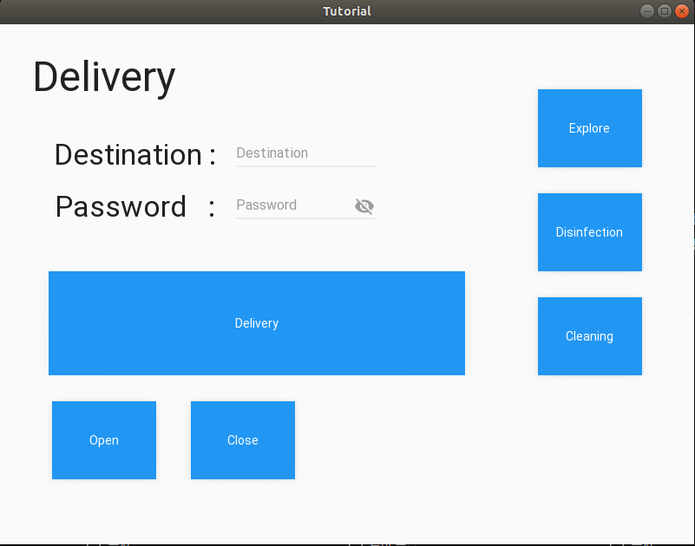
Current Process
Delivery
GUI

Slide 13
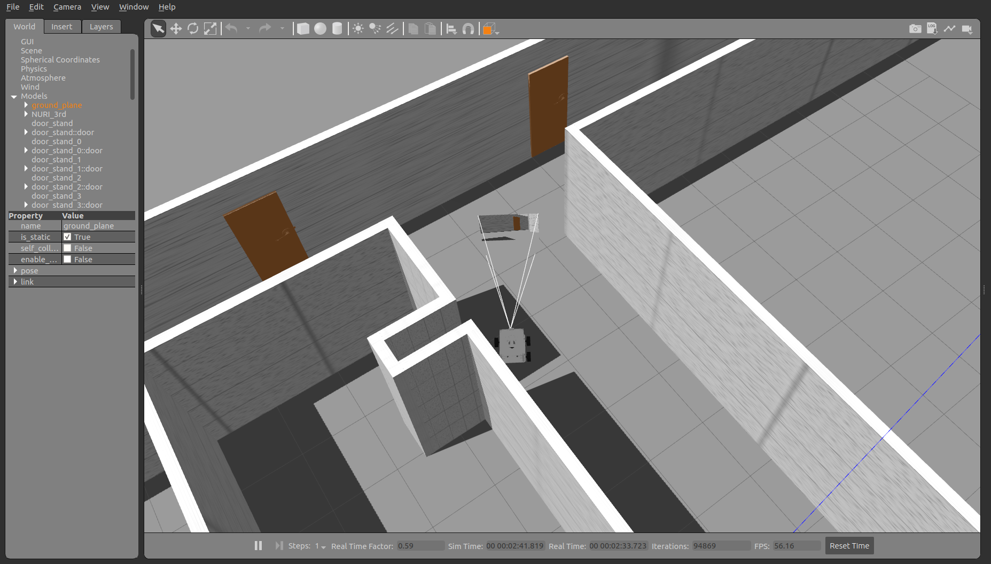
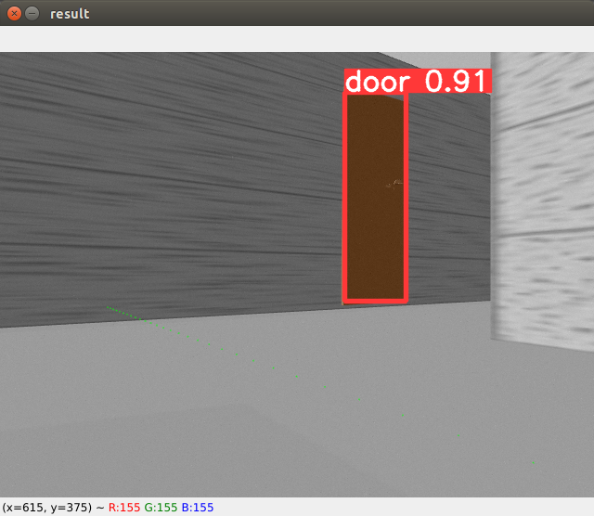
Current Process
Disinfection
YOLOv5 & TensorRT

Slide 14
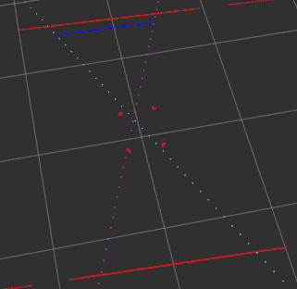
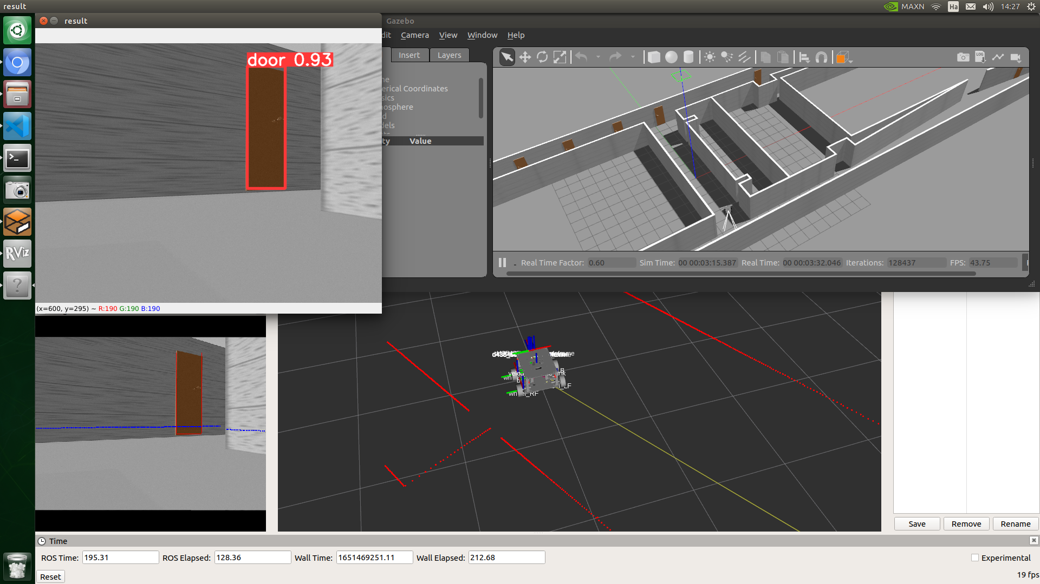
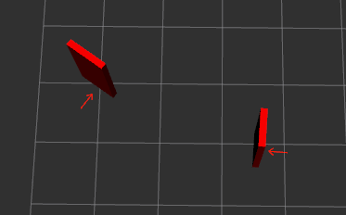
Current Process
Disinfection
Dore pose estimation with 2D LiDAR

Slide 15
Current Process
Cleaning
Wall following

Slide 16
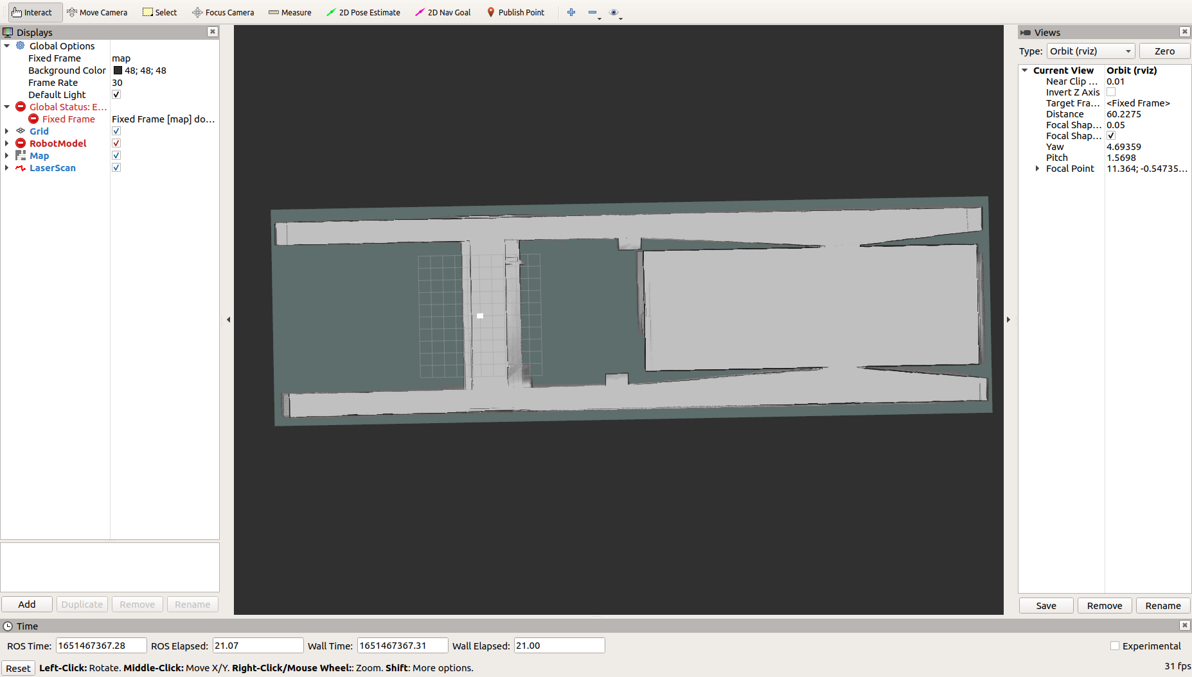
Issues
Cartographer accuracy

Slide 17
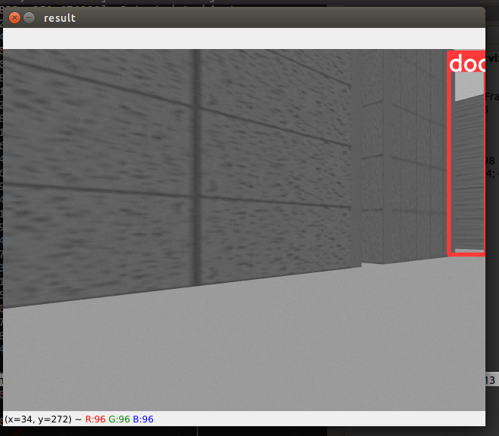
Issues
Filtering False-Positive detection

Slide 18
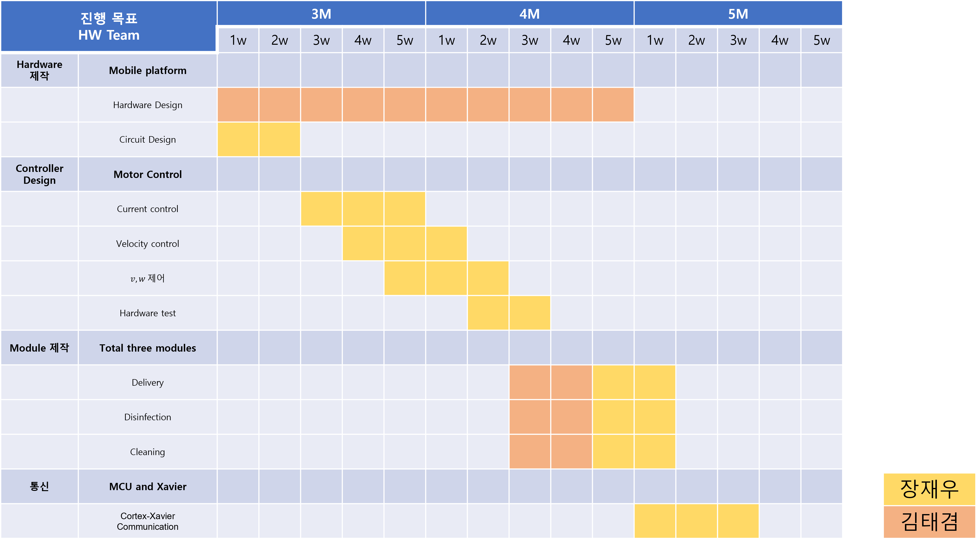
Schedule - HW

Slide 19
Schedule - SW

Slide 20
Q&A
Thank you

